Slide 1
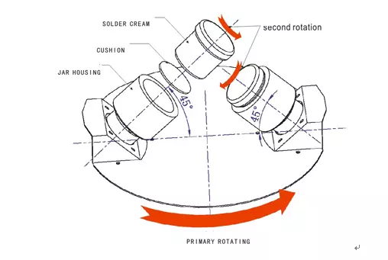
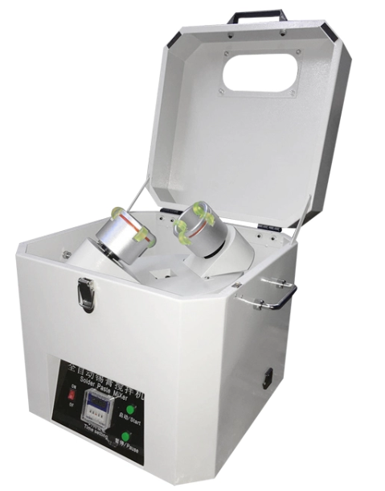
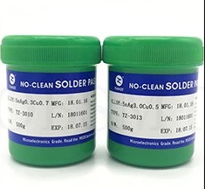
S-SPM01 Solder Paste Mixer
Solder Paste Mixer Serial
Description
It is suitable for mixing common solder paste,paste,glue,slurry,and other material
Features
1，Put the solder paste at 45 degrees ,rotate along the axis direction, solder paste no longer adhere to the Cover.
2，With double safety devices to ensure personal security.
3，Remove air bubbles while stirring.
4，Using a dedicated control circuit, fully taking process control in consideration.
5，Proven speed ratio,avoiding too much solder powder and temperature rise impacts solder paste quality.
6，Don’t need to remove cold storage of solder paste out of ice.
7，500 g solder paste,mixing two cans at the same time.Save time.
8，Mixing process, no need to open the solder paste box.
Specifications
Model | S-SPM01
Machine Size(L*W*H) | 440*440*550mm
Mixing capacity | 500g/jar,2jars/time
Mixing method | Centrifugal mixing
Mixing angle | 45°
Power | 1P AC110/220V 50/60HZ
Revolution speed | 0~1200 RPM/min
Rotation speed | 0~750 RPM/min
Machine Weight | 35kg

Slide 2
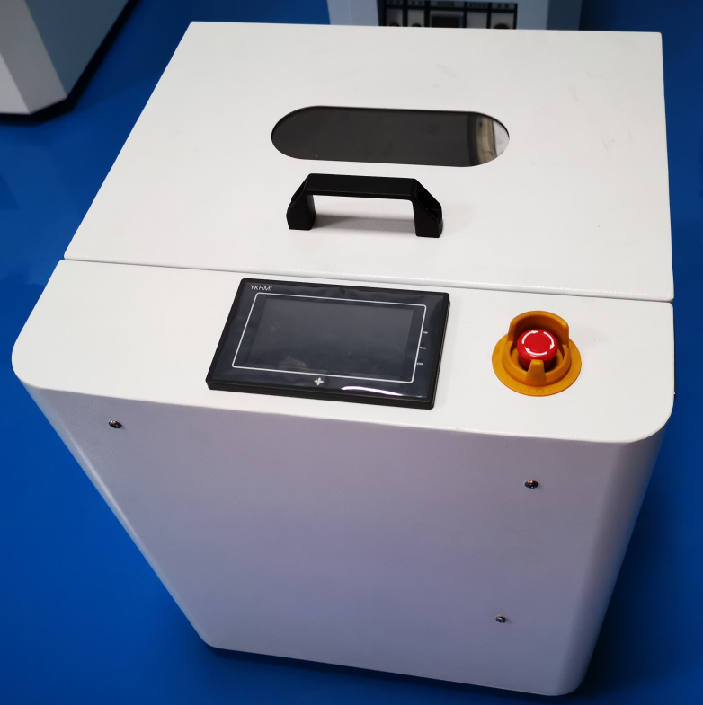
S-PM680 Solder Paste Mixer with touch screen
Solder Paste Mixer Serial
Description
It is suitable for mixing common solder paste,paste,glue,slurry,and other material
Features
1. Touch screen interface, intelligent switch between Chinese and English;
2. [positive rotation], [negative rotation], [positive and negative alternation] and other operation modes are flexibly selected;
3. New digital setting, accurate setting of running speed and time, real-time display of running status;
4. Intelligent diagnosis, automatic shutdown and warning after operation, automatic shutdown alarm when abnormal;
5. Safety protection, open cover or emergency stop immediately stop operation and alarm;
Specifications
Model | S-PM680
Machine Size(L*W*H) | 450X400X436(mm)
Mixing capacity | 500g/jar,2 units at one time
Mixing method | Centrifugal mixing
Mixing angle | 45°
Power | 1P AC110/220V 50/60HZ
Running speed | 300-2400（RPM）
Operating Mode | LCD touch screen (resistive)
Main Control Unit | ARM-Cortex microprocessor
Machine Weight | 40 kg

Slide 3
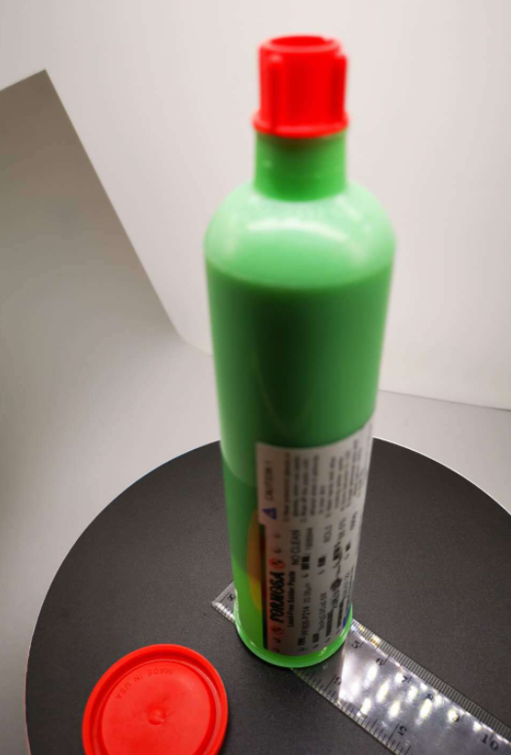
S-PM550 Needle Tube Solder Paste Mixer
Solder Paste Mixer Serial
Description
It is suitable for mixing common solder paste,paste,glue,slurry,and other material
Features
1，Put the solder paste at 45 degrees ,rotate along the axis direction, solder paste no longer adhere to the Cover.
2，With double safety devices to ensure personal security.
3，Mixing theory based on revolution and motor rotation of the mode of agitation.
4，Micro PC digital control, operation easily.
5， Applicability strong, in both omnipotent fixture applies to all brands of Tinol.
6，Multiple security protection to ensure safe operation
Specifications
Model | S-PM550
Machine Size(L*W*H) | 500×500×650mm
Mixing capacity | 700g/jar,,2 units/once
Mixing method | Centrifugal mixing
Mixing angle | 45°
Power | 1P AC110/220V 50/60HZ
Time of agitation | Suggested 3-5min
Revolution speed | 0~1200 RPM/min
Rotation speed | 0~750 RPM/min
Machine Weight | 70kg

Slide 4
WELCOME INQUIRY
Please visit
www.smthelp.com
Find us more
https://www.facebook.com/autoinsertion
Know more our team
https://cn.linkedin.com/in/smtsupplier
Welcome to our factory in Shenzhen China
See more machine working video, please Youtube
Auto Insertion
Google
Auto+insertion, to get more informations
Looking forward to your email
wendy@smthelp.com

